Slide 1
Introduction to CSS
Introduction to CSS & Rules | CSS Properties | Colors
Notes:
Welcome to our lecture on Introduction to CSS. In this lecture we will go through the introduction to css, it’s rules, and colors in the css. So let’s start the lecture.

Slide 2

Introduction to CSS & Rules
Default styling: Webpages use a white background and black text without styling.
CSS: A language for controlling the visual presentation of webpages.
CSS Rule: Specifies styles for HTML elements using property-value pairs.
Placement: CSS rules can be added inside the <style> tag in the HTML head.
Notes:
Today, we are introducing CSS and its rules. By default, webpages use a white background and black text without styling. CSS, or Cascading Style Sheets, is a language used to control the visual presentation of webpages. A CSS rule defines the styles for specific elements using property-value pairs. CSS rules can be placed inside the style tag in the head section of the HTML file for better control over design.

Slide 3
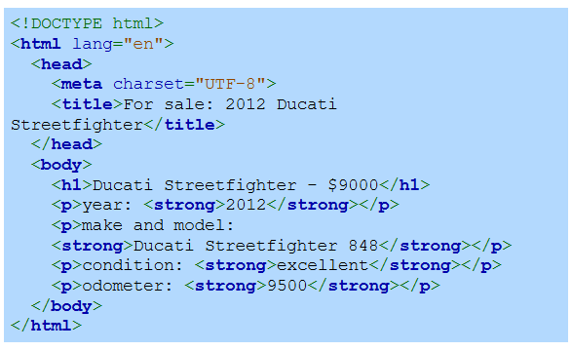

Sample HTML Code without CSS
Notes:
Here is an example of an HTML document without CSS. On the left is the code, which uses basic HTML tags like h1 for the heading and p for paragraphs. Bold formatting is applied using the strong tag. On the right, you can see the default browser rendering with a plain white background, black text, and minimal styling. CSS can be used to enhance the appearance and layout of this content.

Slide 4
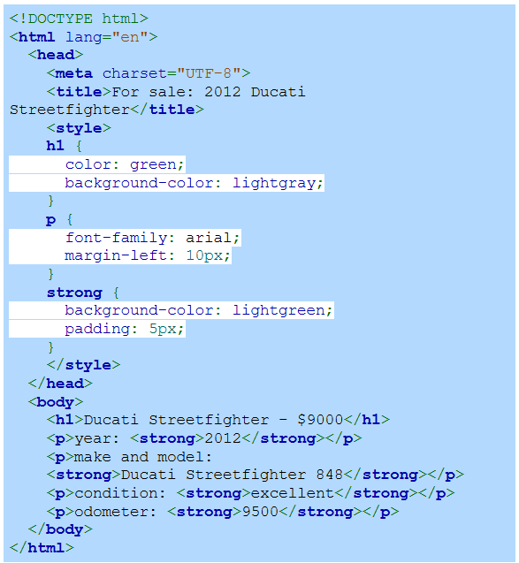
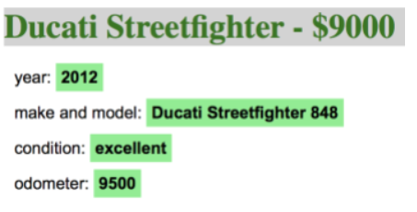
Sample HTML code with CSS
Notes:
On the other hand an example of an HTML document with CSS applied is shown. On the left, the code includes a <style> tag where CSS is used to customize the appearance. The heading is styled with green text and a light gray background. The p elements have a specific font and margin, while strong tags have a green background with padding. On the right, the CSS effects can be seen improving the visual presentation.

Slide 5
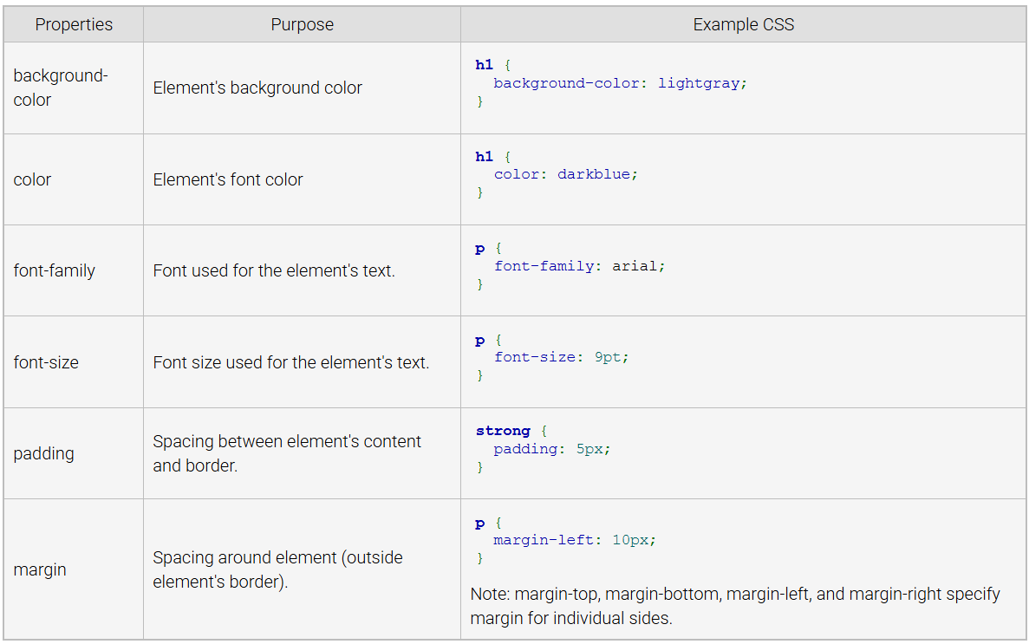
Common CSS Properties
Notes:
Now move on to some common CSS properties used for styling web elements. The table explains key properties: background-color sets the element's background color, color controls the font color, font-family specifies the text style, and font-size sets text size. Padding adds space inside the element's border, while margin adds space outside the border. Examples for each property are shown in the table.

Slide 6
Colors
CSS colors: Can be a named color like blue or an rgb value like rgb(50, 100, 255).
RGB: Stands for red, green, blue, the primary colors for digital screens.
Values: Range from 0 (none) to 255 (bright) for each color channel.
Notes:
Finally, we will discuss the CSS colors. CSS allows colors to be defined using named values like blue or with an rgb value such as rgb(50, 100, 255). RGB stands for red, green, blue, the primary colors used for digital displays. Each color channel can have a value ranging from 0 (none) to 255 (brightest), allowing the creation of a wide range of colors for web design.

Slide 7
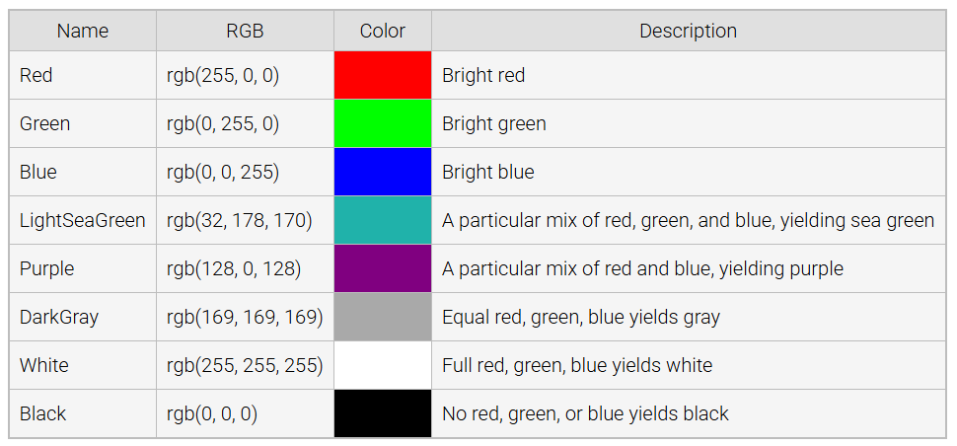
Some CSS Colors
Notes:
The table here show some common CSS colors. The table lists color names, their corresponding rgb values, a visual color sample, and a brief description. Red, green, and blue represent primary colors with maximum intensity in their respective channels. LightSeaGreen and Purple result from mixing different levels of red, green, and blue. Equal RGB values create gray, while white and black represent all or no colors respectively.

